Slide 1

Project: Ice Cream

Slide 2
Table of Contents
Introduction
Technologies Used
Why we used ASP .NET MVC?
Database Diagram
Problems/ Requirements
Installation Guide

Slide 3
Introduction
Introducing the Ice-Cream Website, a visionary project led by Mr. "A," the owner of a celebrated ice-cream parlor. With a dynamic website at its core, the objective is to not only showcase the delectable range of ice creams but also create an interactive platform for enthusiasts to explore the art of dessert creation. Boasting features for both registered and unregistered users, the portal aims to enhance the shop's online presence, facilitate recipe distribution, sell exclusive books, and foster customer engagement through feedback. Key elements include a user-friendly home page, secure registration with subscription options, online ordering of recipe books, an engaging "About Us" section, and an admin dashboard for seamless management. Developed using ASP.NET MVC, Ice-Cream Paradise strives to unite dessert lovers and elevate the joy of ice cream through a captivating online experience.

Slide 4








Technologies Used
This is a full-stack project involving both front-end and back-end technologies.
Front End
Back
End

Slide 5







Why we used ASP .NET MVC?
So Why we only used ASP .NET MVC when we had many alternative frameworks?
Benefits of ASP.NET MVC over other alternatives
MVC Architecture
Optimized for making large and heavy projects/programs
Easier Debugging Capabilities
Scaffolding Feature allows ready made basic Crud
Integrated Security Features
Extensive Community and Documentation
Flexible Routing System
IDE Integration with Visual Studio
Built-in Support for Dependency Injection
Automatic State Management with TempData

Slide 6
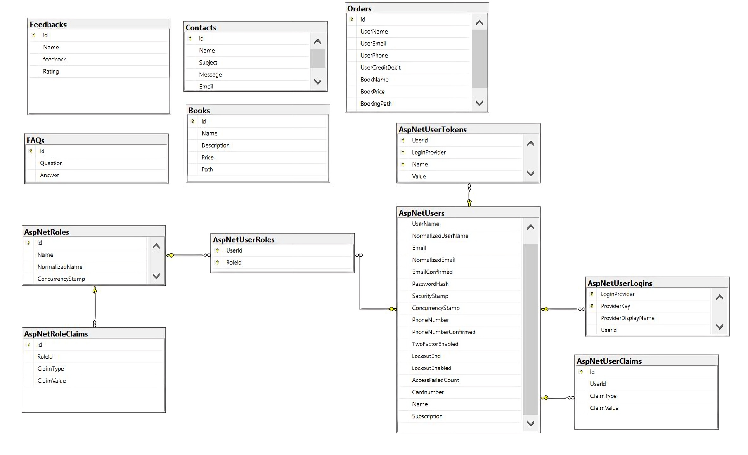
Database Diagram

Slide 7
Problems/Requirements
Website Structure and Navigation: 1
User Registration and Login: 2
Book Ordering System: 3
Feedback Form: 3
About Us: 1
Contact Us: 1
Registered User Features: 2
Flavor Details for Registered Users: 2
Admin Panel: 6
General Requirements: 3
Total: 24.

Slide 8
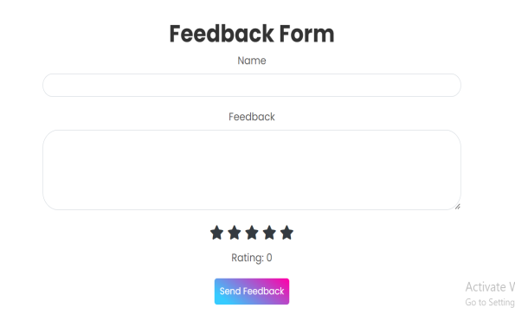
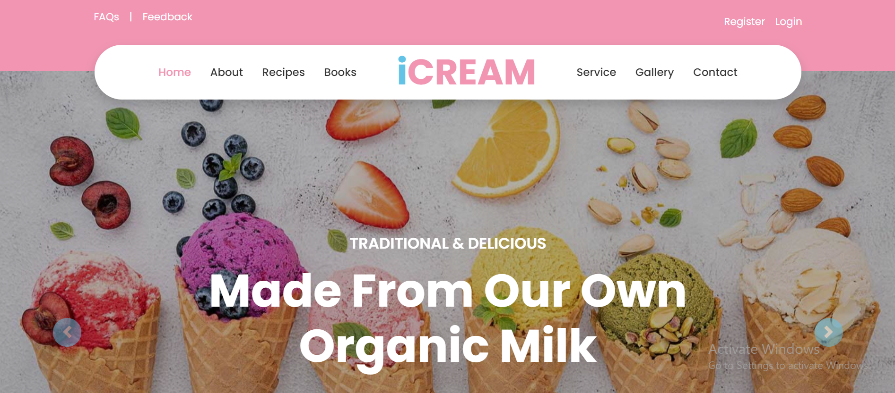
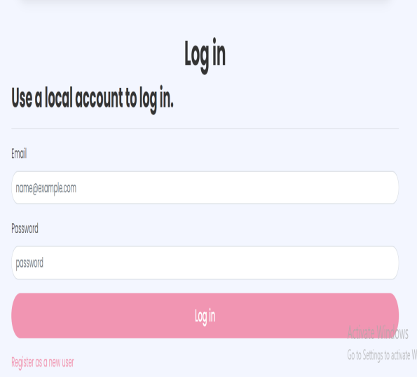
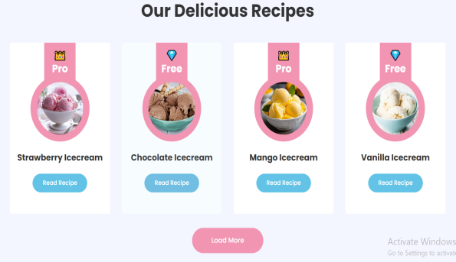
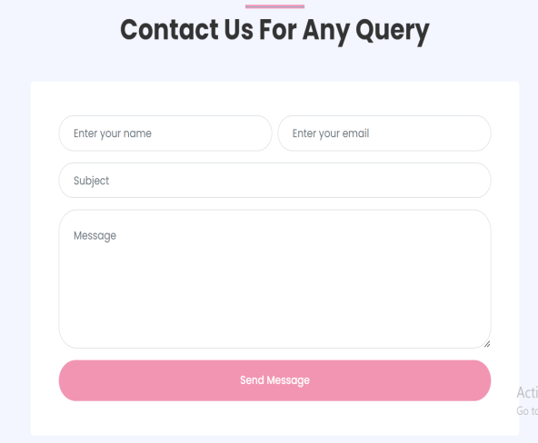
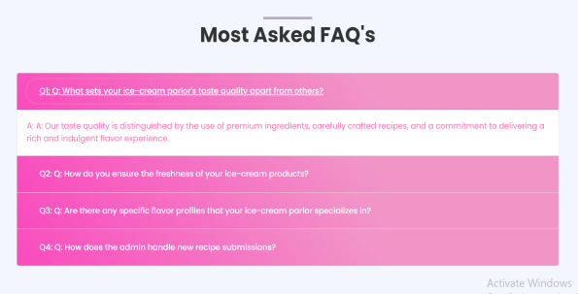
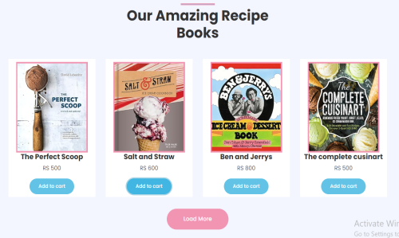
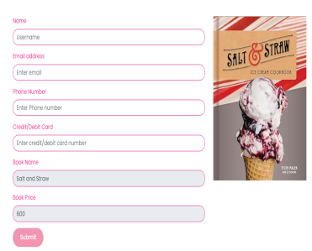
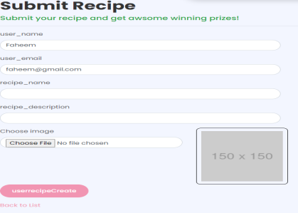
1) Website Structure and Navigation:
1.1 Create a home page with menus for home, login, free recipes, contact us, feedback, adding recipe, FAQs, and ordering recipe books.
Feedback
Login Page
Recipes
Home Page
FAQ’s
Books
Books Checkout
User Recipe Submit
Contact Us

Slide 9
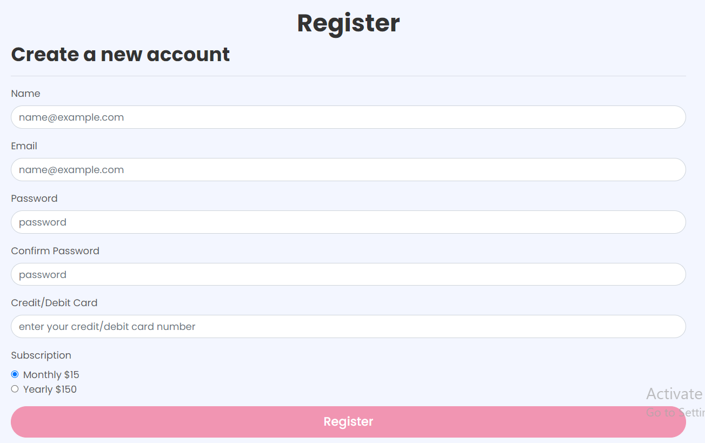
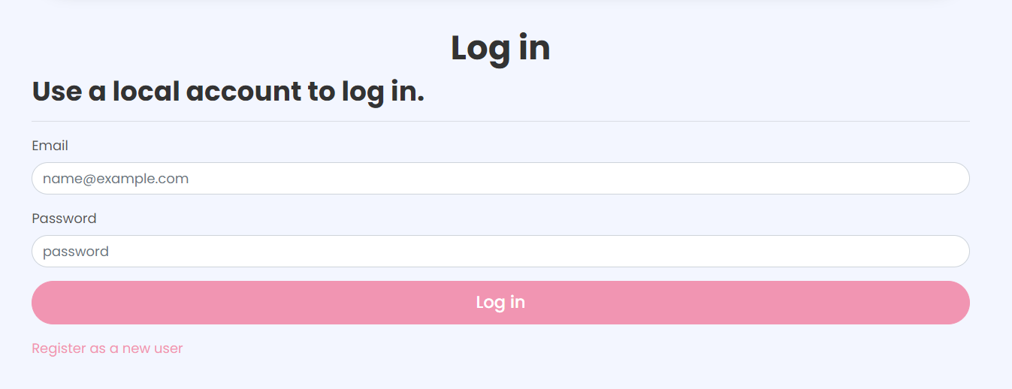
2) User Registration and Login:
2.1 Develop a registration page allowing users to register by making payment(monthly or yearly).
2.2 Implement a login system for registered users with a username and password.

Slide 10
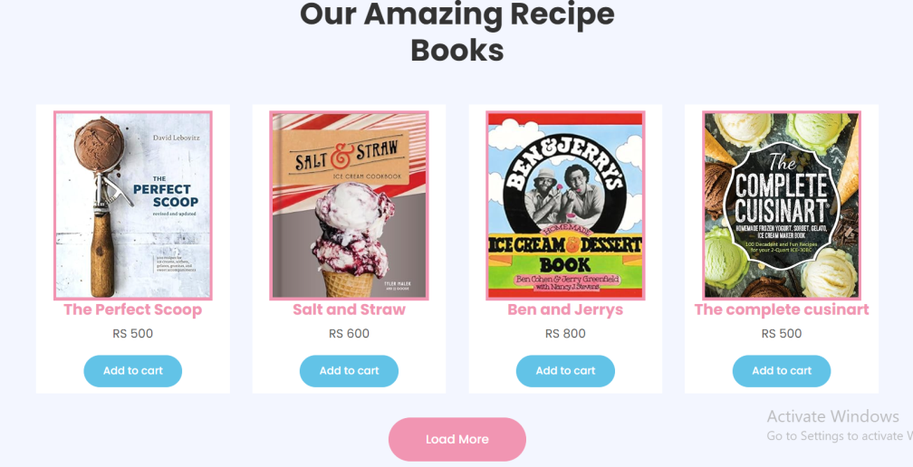
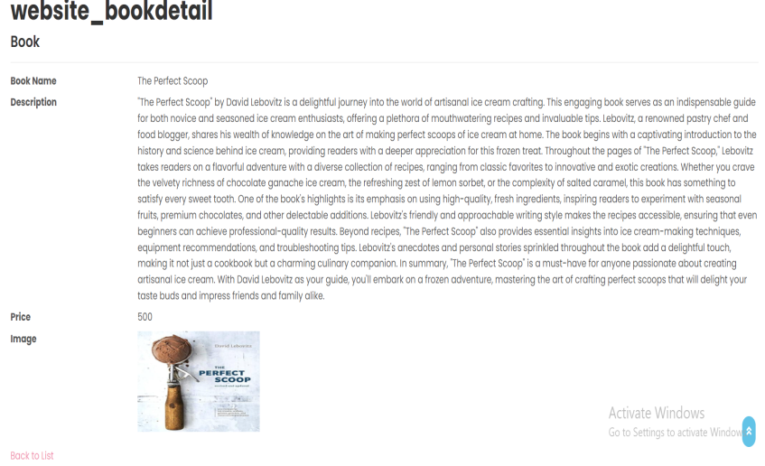
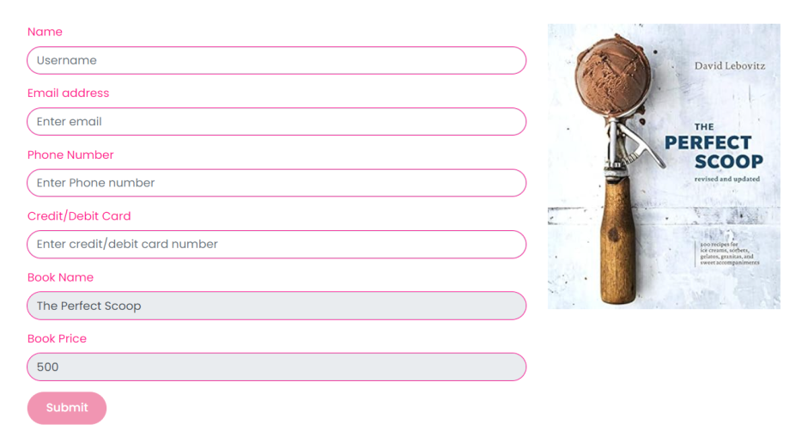
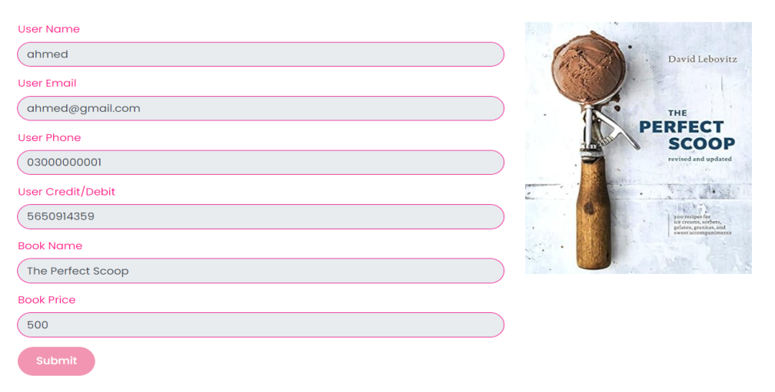
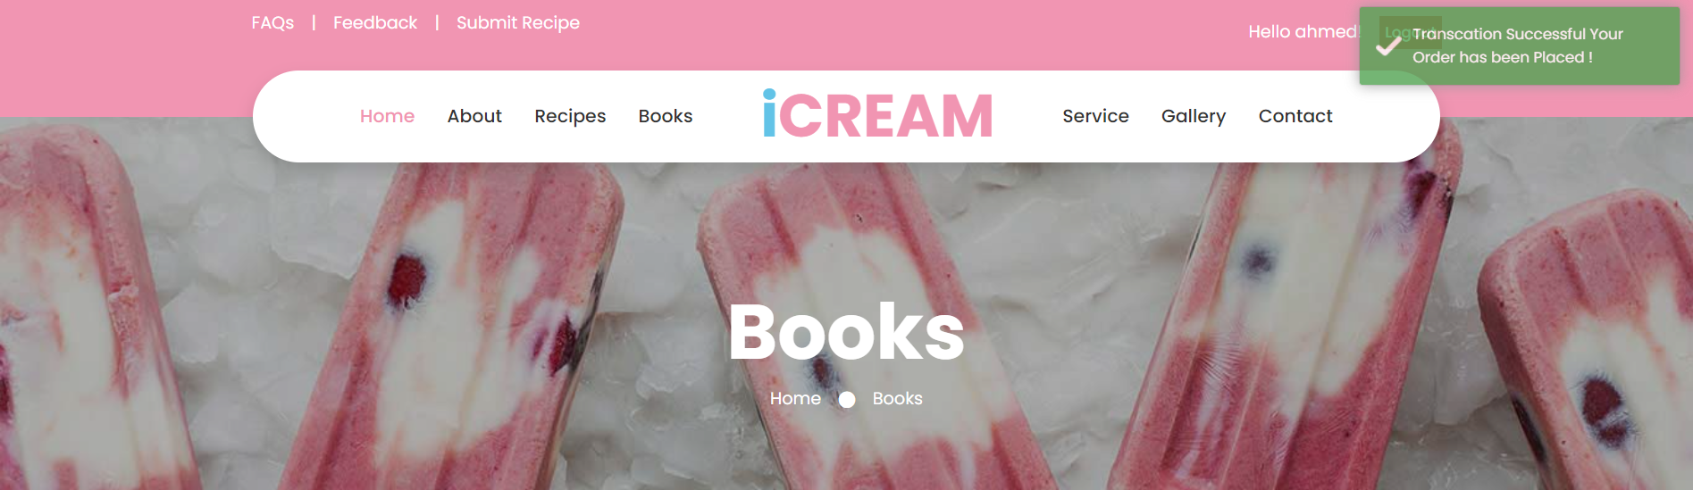
3) Booking Order System:
3.1 Design an online order page for books with images, descriptions, and prices.
3.2 Collect user details like name, email, contact, address, and payment information securely.
3.3 Display a confirmation message after a successful transaction.
Books Page
Book Detail Page
Book Checkout Page
For registered user
Book Checkout Page
For unregistered user
Toaster Popup on placing order successfully

Slide 11
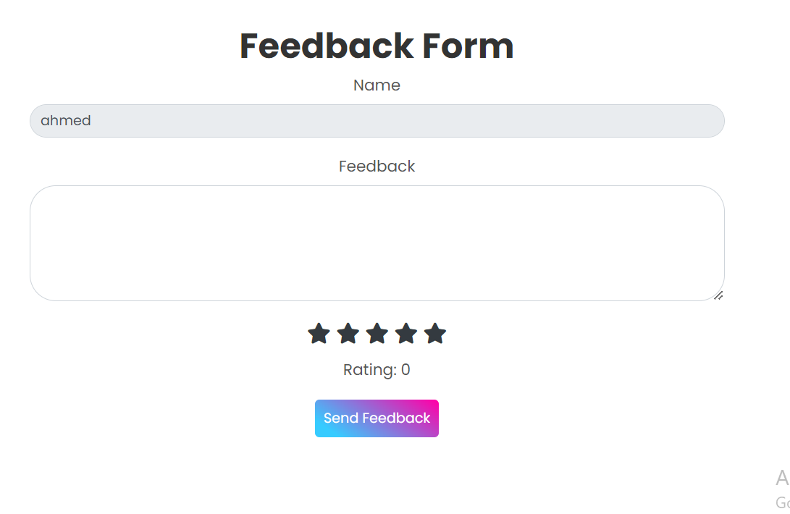
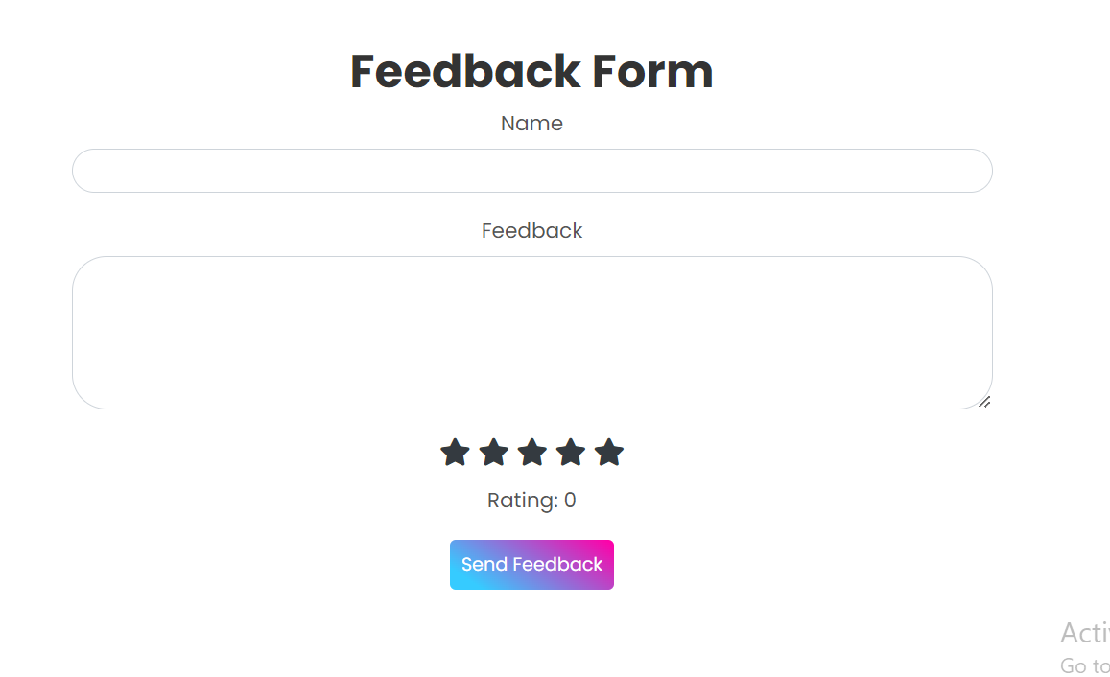
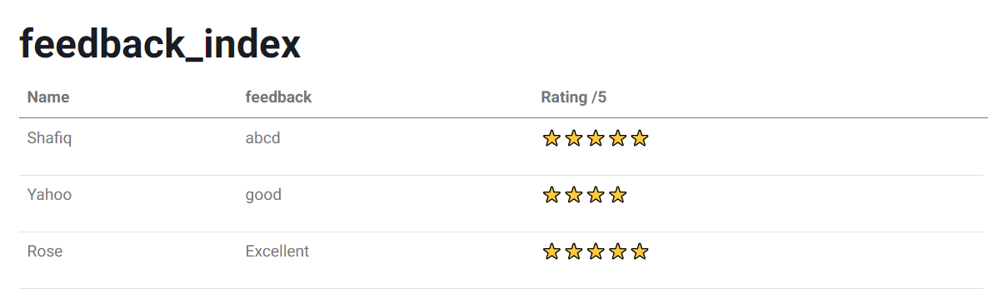
4) Feedback Form:
4.1 Create a feedback form for both registered and unregistered users.
4.2 Ensure the form collects valuable feedback and suggestions.
4.3 Implement a system to store and view feedback data.
Feedback Form
For registered user
Feedback Form
For unregistered user
After user submits feedback the feedback stores in database and all users feedbacks are displayed to admin in admin panel

Slide 12
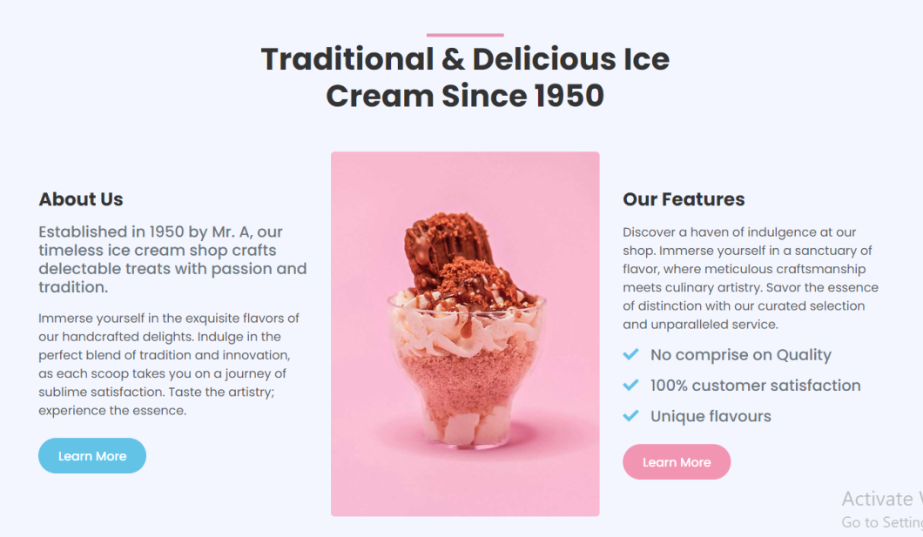
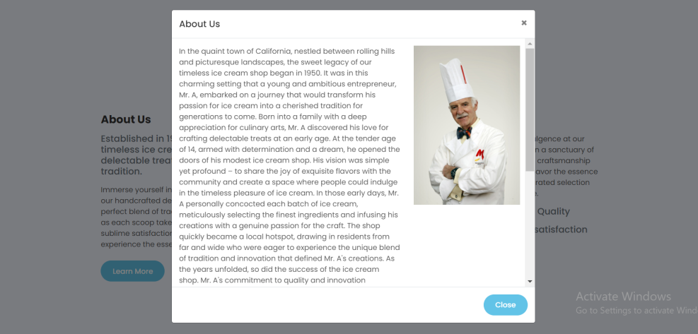
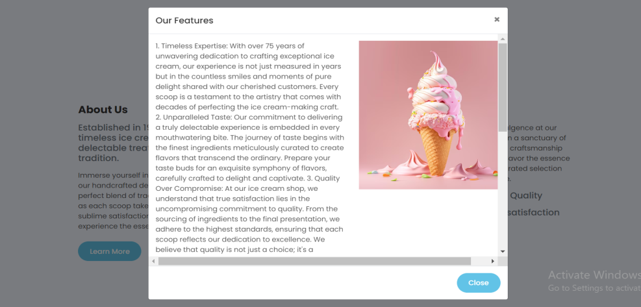
5) About Us:
5.1 Develop an 'About Us' page describing the ice-cream parlor and the owner.
About Us page
On clicking this button About us modal pops up
On clicking this button Our features modal pops up

Slide 13
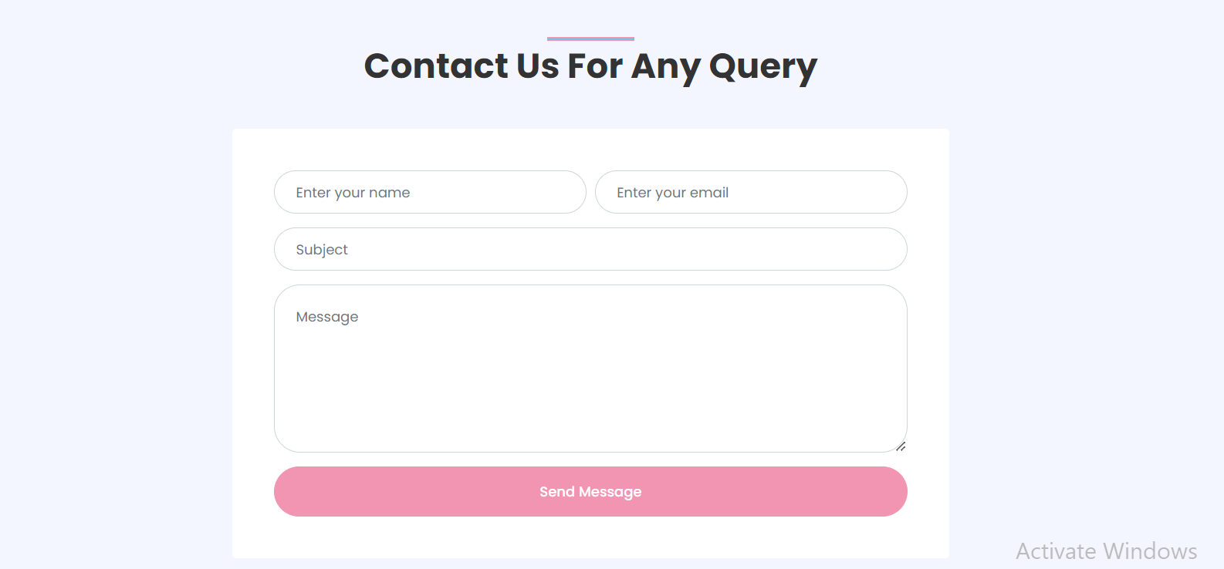
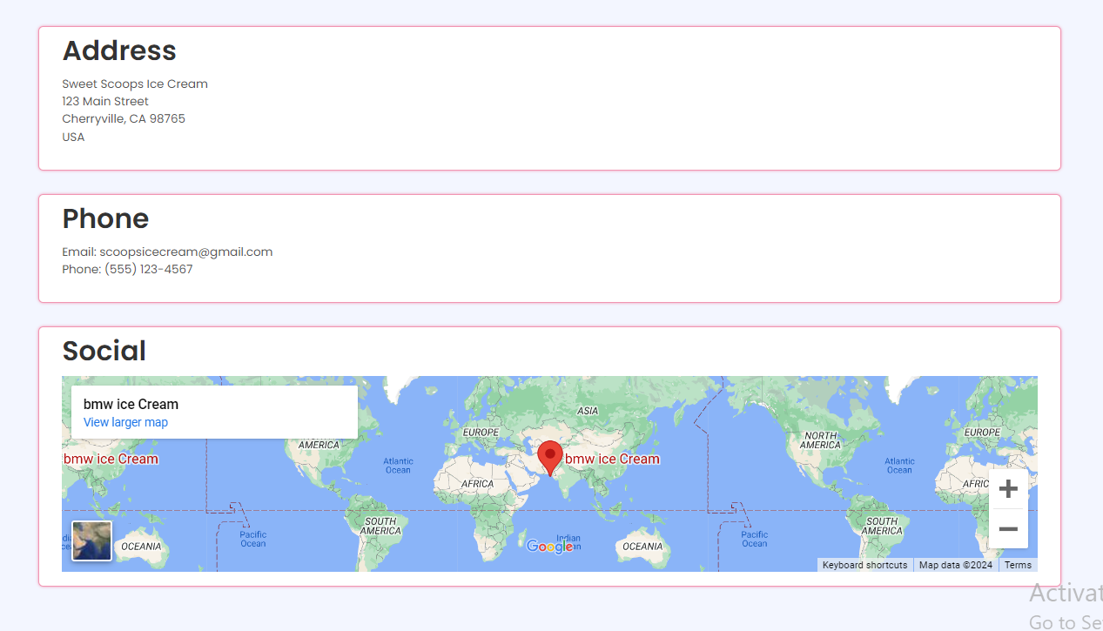
6) Contact Us:
6.1 Design a 'Contact Us' page displaying relevant contact details.
Contact Us form with relevant contact details been displayed

Slide 14
7) Registered User Features:
7.1 Enable additional features for registered users, such as accessing famous flavors.
7.2 Implement links and functionalities specifically for registered users.
8) Flavor Details for Registered Users:
8.1 Enable access to details for flavors mentioned (ingredients, procedure) for registered users.
For Registered Users:
For Unregistered Users:
Registered Users have access to all of the user functionalities including:
Accessing pro recipes
Submitting Recipes
Unregistered Users have access to all of the user functionalities excluding:
Accessing pro recipes
Submitting Recipes

Slide 15
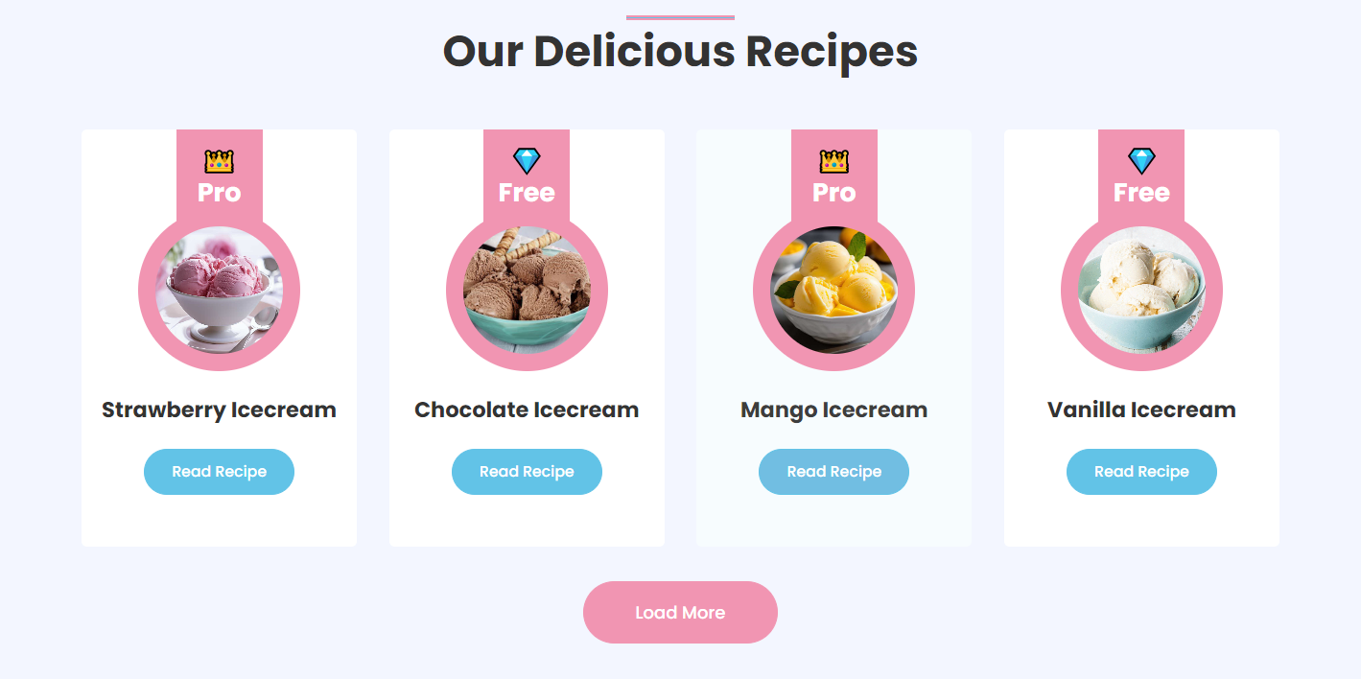
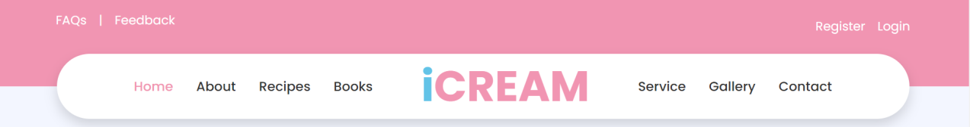
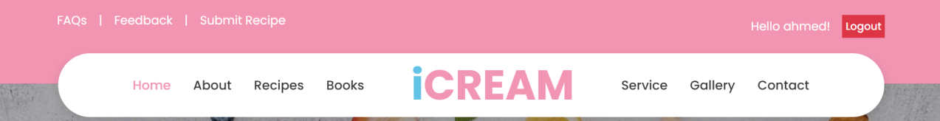
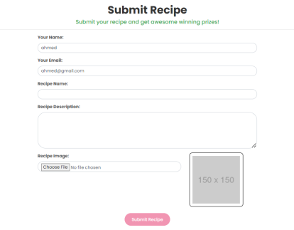
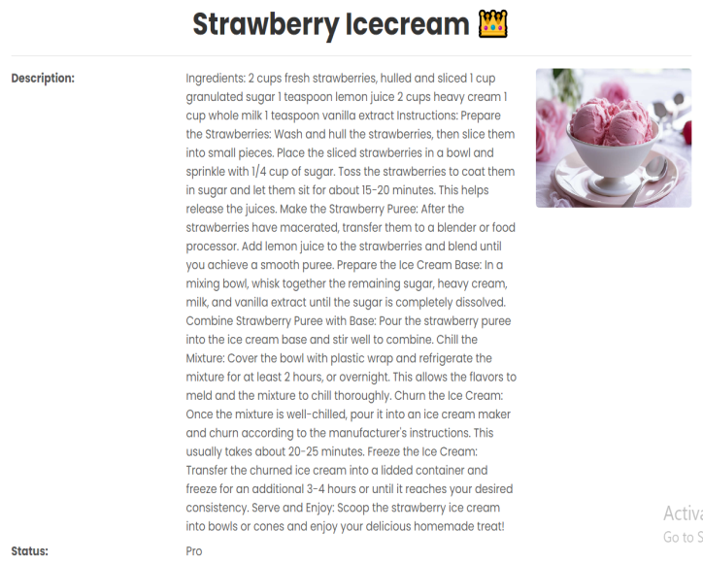
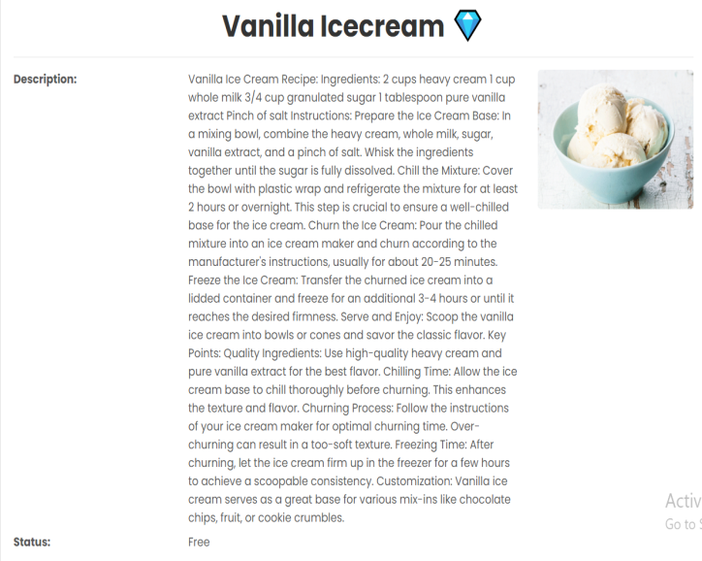
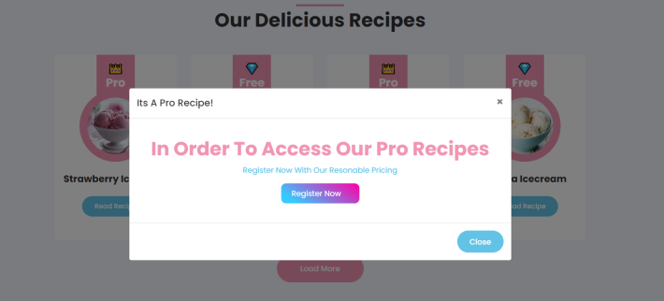
For Registered Users
He have access to submit his recipe
For Registered Users
For Unregistered Users
He could access both
He could only free one
If he tries to access pro recipe he would be redirected to a registration modal popup

Slide 16
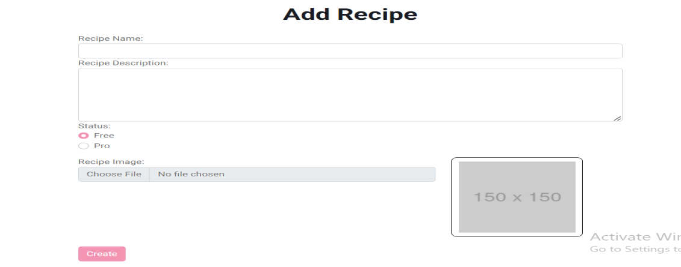
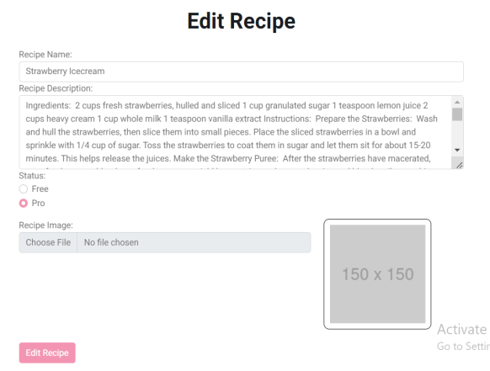

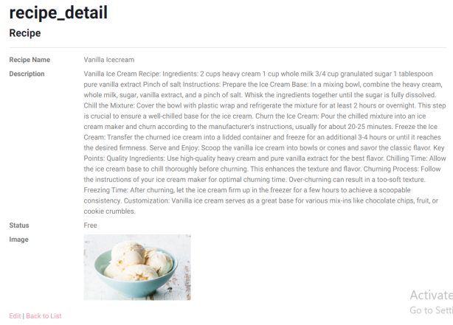
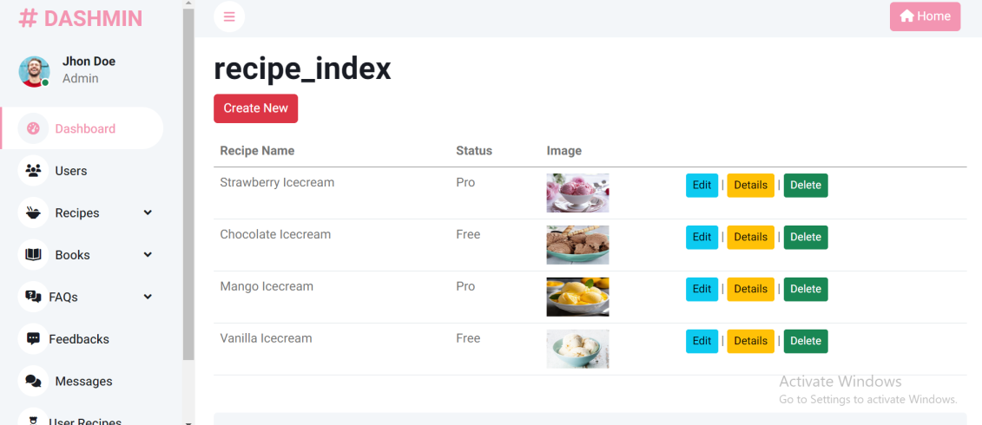
8.2 Allow the admin to update and add new flavors and their details.
On Admin Panel
On Website
Add Recipe Page
Edit Recipe Page
Recipes Display
Adding Recipe Button
Edit Recipe Button
Recipe Delete Button
Recipe Detail Page
Recipe Detail Button
Recipes List Display

Slide 17
9) Admin Panel:
9.1 Create a secure login page for admin access
9.2 Enable admin functionalities to add and update recipe details.
Already mentioned on previous page
Login Page

Slide 18

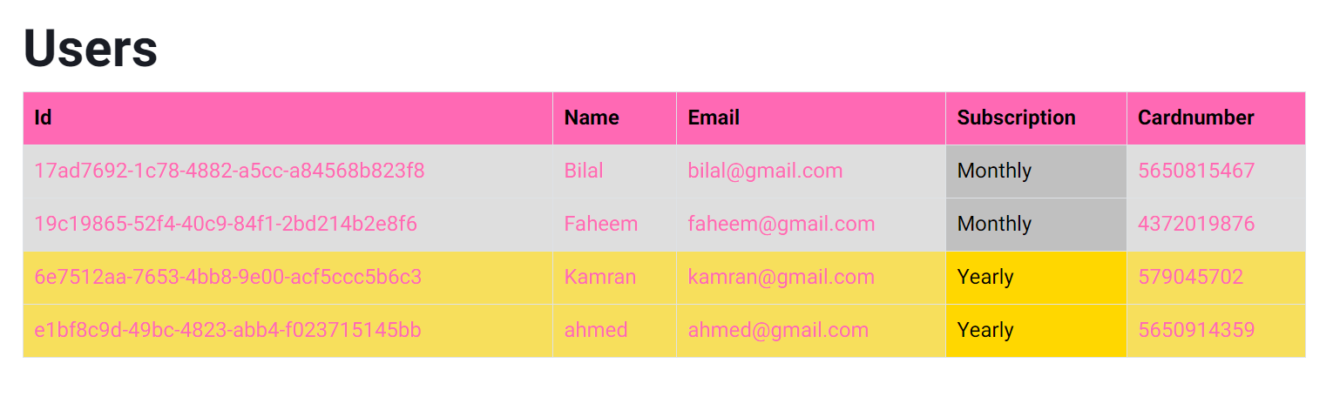

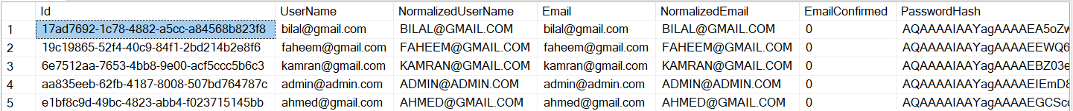
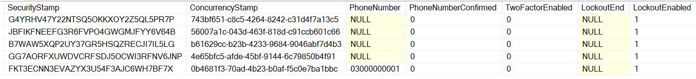
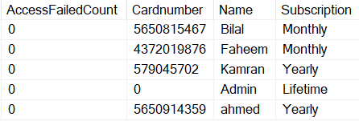
9.3 Implement a system to check and manage registered users and their payment details.
On Website
On Admin Panel
1)First of all user will register himself on register page
Users Registered on Monthly Subscription are highlighted with silver color and for Yearly subscription are highlighted with golden color
3)From database the registered users data is getting displayed in list form on user index page
2)As he registers successfully user data goes into the database

Slide 19
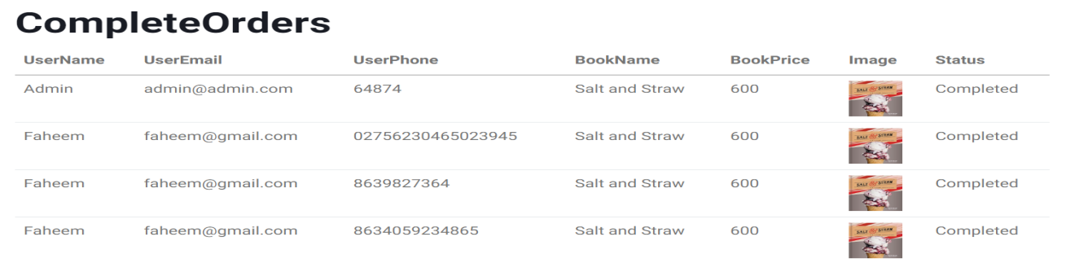
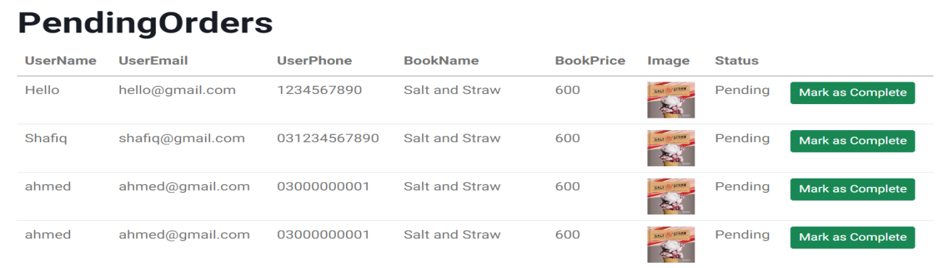


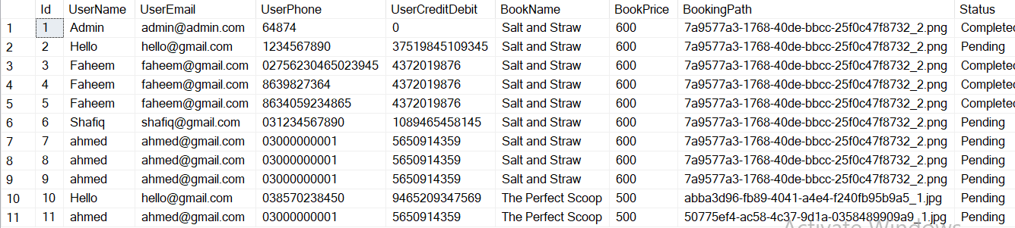
9.4 Develop features to monitor and update the status of book orders.
Books can be ordered by both Registered and Unregistered Users
On Website
On Admin Panel
Completed Orders page
After clicking on this button the order status of that particular order changes from pending to completed and the order goes from pending to completed orders page
Books Page
Pending Orders page
After Checkout Data goes into database with by default status of pending
Books Checkout

Slide 20
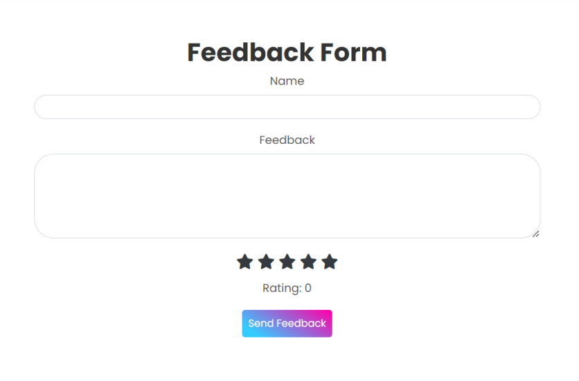
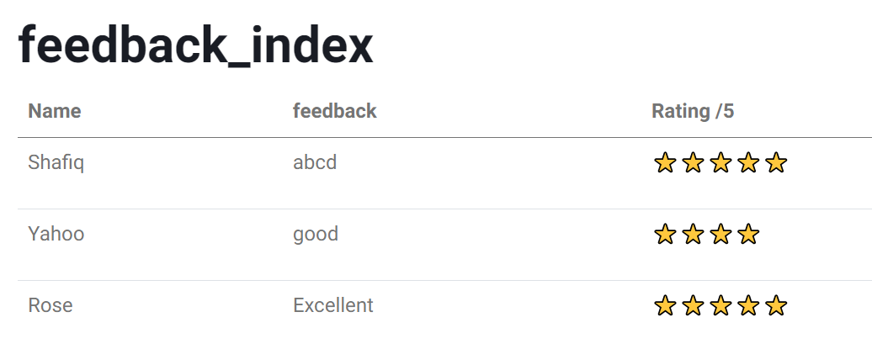
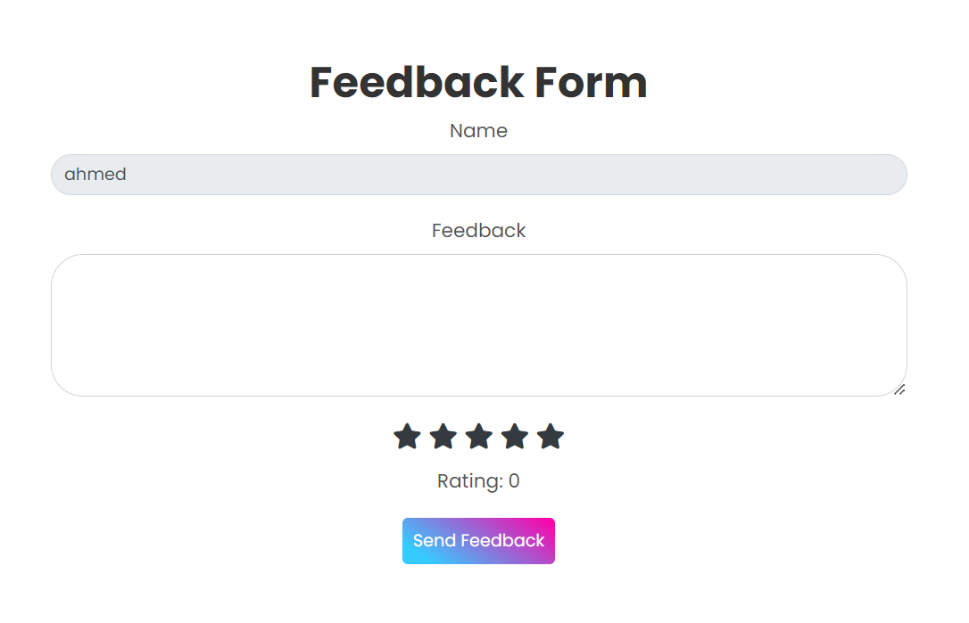
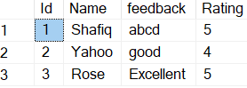
9.5 Implement a module to review and manage user feedback.
Feedback can be given by both Registered and Unregistered users
On Website
On Admin Panel
Feedback Form
For registered user
From database the registered users data is getting displayed in list on feedback index page
After clicking send feedback button the data goes into database
Feedback Form
For unregistered user

Slide 21
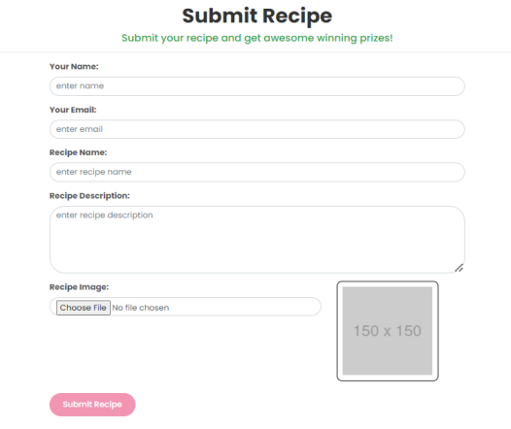
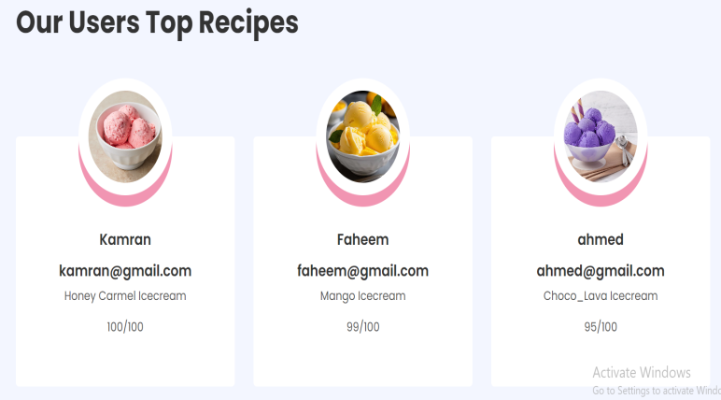
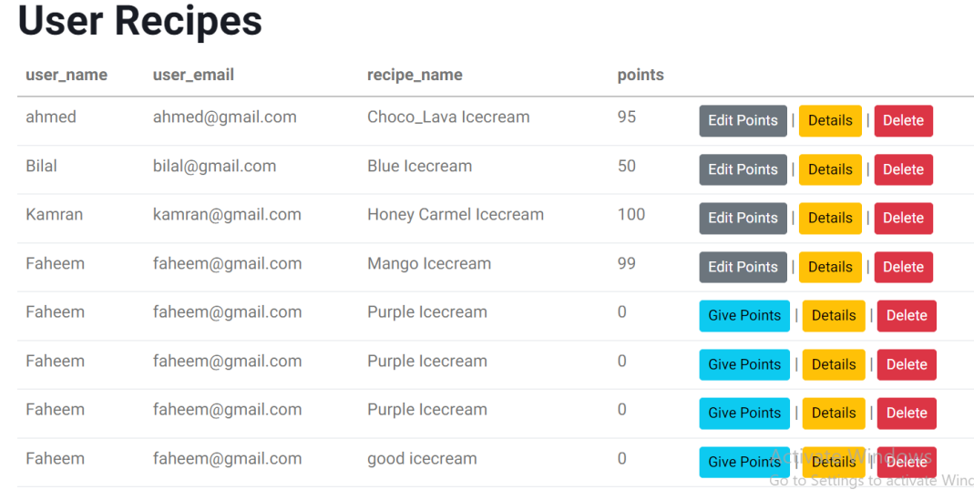





9.6 Enable the admin to check details of new recipes submitted by users.
Recipes can be submitted by both Registered and Unregistered users
On Website
On Admin Panel
Submit recipe page
For registered user
Admin will go through users recipe and then give the points on the basis and analysis of recipe and the user with top 3 highest points would rank on homepage
From database the users recipes data is getting displayed in list on user recipe index page
Redirection to edit points page
Redirection to edit points page
After clicking submit recipe button the data goes into database
Submit recipe page
For unregistered user

Slide 22








10) General Requirements :
10.1 Ensure the website is user-friendly and responsive.
Our Design is user-friendly and responsive across all screen sizes
Website

Slide 23




Our Design is user-friendly and responsive across all screen sizes
Dashboard

Slide 24


10.2 Implement proper security measures to protect user data.
In our website there are excellent security measures taken to protect user data.
1) In our Database whenever a user registers our changes his/her password the passwords are hashed in database by why hackers and admin could not easily see it or access it even the hackers could not brute force the password. And user id of every user is also hashed.
2) We have kept input type password whenever user login or registers types his password the characters are been hidden from others and are even saved from spyware and if a user want to secure himself from key logger attack so user should always use his mouse to fill up the private credentials.

Slide 25





3) If the User wishes to update his/her password so he could update it easily
10.3 Provide user notifications for successful transactions, feedback submissions, etc.
On website
Feedback send success notification
Recipe submit success notification
Message send success notification
Book order placed success notification

Slide 26









Recipe added success notification
Recipe updated success notification
Recipe deleted success notification
On Admin Panel
Book added success notification
Book updated success notification
Book deleted success notification
FAQ added success notification
FAQ updated success notification
FAQ deleted success notification

Slide 27

On Admin Panel
Order status changed to completed notification

Slide 28



Installation Guide
In Order to Install the Project follow these following steps:
Step1: First of all we need two software's visual studio and sql server management studio
Step2: Download the project from this link below
https://www.mediafire.com/file/wok3m5lu2c6arwh/Icecream.rar/file
Step3: Then open file and select Icecream.sln

Slide 29


Step4: After clicking on Icecream.sln project will open up in visual studio
Step5: Open appsettings.json

Slide 30


Step6: Open Sql server management studio and copy the server name
Step7: Now paste the server name in appsetting.json
over here replace your server name

Slide 31

Step8: Now on visual studio and from top select Tools/Nuget Package Manager/Package Manager Console

Slide 32

Step9: After Console opens up write update-database and hit enter
Step10: After it shows build successful in console congrats you are ready to go now you just need to click on https
Click this to run project
To reload project
To stop project click this

Slide 33

namespace HelloWorld { class Hello { static void Main(string[] args) { System.Console.WriteLine(“Thank You!"); } } }

